Slide 1

ADIKAVI NANNAYA UNIVERSITY UNIVERSITY COLLEGE OF ENGINEERING DEPARTMENT OF COMPUTER SCIENCE AND ENGINEERING RAJAMAHENDRAVARAM
Sentimental Analysis from Text Using Deep Learning
GUIDANCE BY
Mrs. Jayanthi Harini
Assistant Professor
Department of Computer Science and Engineering
PRESENTATION BY
P.Sushma
208297601042
IV B.Tech CSE

Slide 2
Contents
ABSTRACT
PROBLEM STATEMENT
INTRODUCTION
EXISTING SYSTEM
PROPOSED SYSTEM
FUNCTIONAL AND NON FUNCTIONAL REQUIREMENTS
7. SOFTWARE AND HARDWARE REQUIREMENTS
8. SYSTEM ARCHITECTURE
9. UML DIAGRAMS
10. IMPORTING LIBRARIES AND LOADING DATASET
11. DATA PREPROCESSING AND DATA SPLITTING
12. MODEL BUIDING AND EVALUTION
13. OUTPUT SCREENS
14. CONCLUSION AND FUTURE SCOPE

Slide 3
ABSTRACT
Sentiment analysis, a crucial component of natural language processing, plays a pivotal role in understanding the emotional tone expressed in textual data. In this project, an approach is proposed for sentiment analysis by using a deep learning model of Long Short-Term Memory (LSTM) networks and word embeddings like Bidirectional Encoder Representations from Transformers (BERT).

Slide 4

PROBLEM STATEMENT
In the era of massive textual data generated across digital platforms, existing sentiment analysis approaches fall short in providing nuanced and real-time insights into the emotional tone of language. The challenge lies in creating a system that not only automates sentiment classification but also comprehends the complex contextual nuances, varying writing styles, and linguistic expressions present in diverse datasets. The project aims to address this by developing a deep learning model that uses recurrent architecture to achieve an efficient sentimental analysis solution.

Slide 5
INTRODUCTION
Sentiment analysis, also known as opinion mining, is the computational task of determining the sentiment whether it is positive, negative or neutral conveyed within a piece of text. This project begins on a journey into the domain of sentiment analysis, leveraging the power of deep learning to investigate and solve the intricate nuances embedded in textual data.
As the internet and social media platforms continue to serve as large number of mediums for communication, the analysis of user-generated content has gained supreme importance. Individuals, businesses, and organizations seek to extract valuable insights from vast datasets comprising customer reviews, social media posts, and textual feedback. Traditional sentiment analysis approaches often fall short in capturing the complexity of human language and context. Deep learning, a subset of machine learning provides a powerful and intense tool for natural language understanding and sentiment classification.

Slide 6
EXISTING SYSTEM
Emotions from the text are detected manually by humans by analyzing the content present in the text. This consumes lot of time for analyzing the data.
Traditional Machine Learning Approaches:
Machine learning algorithms such as Decision Tree, Random Forest and Logistic regression. These models often use derived features and may struggle with capturing complex linguistic patterns.
Limitations:
1.Difficulty in Handling Long-Range Dependencies
2.Fixed-Length Feature Vectors
3.Difficulty in Capturing Subtle Sentiments
4.Inability to learn from Unstructured Data
5.Limited Generalization Across Writing Styles

Slide 7
PROPOSED SYSTEM
The proposed system introduces a deep learning architecture that uses Long Short-Term Memory (LSTM) networks and word embeddings BERT(BERT stands for Bidirectional Encoder Representations from Transformers). This architecture aims to capture both local patterns and long-range dependencies in textual data, providing a more nuanced understanding of sentiment.
The proposed system is designed with scalability in mind, allowing the system to perform well across different linguistic styles and domains.

Slide 8
FUNCTIONAL REQUIREMENTS
1.Text Input Handling : The system should accept textual input for sentiment analysis from various sources, including user inputs, social media posts, reviews.
2.Preprocessing : Including tokenization and removal of stop words.
3.Word Embeddings : contextual embeddings BERT.
4.Deep Learning Model : Long Short-Term Memory (LSTM) networks .
5.User Interface : Develop an user interface that allows users to input text for sentiment analysis and receive the corresponding sentiment classification.
6.Prediction Module: Implement a prediction module that applies the trained model to new data and outputs the predicted sentiment class (positive , negative and neutral).

Slide 9
NON-FUNCTIONAL REQUIREMENTS
Performance:
The system should exhibit good performance, processing for sentiment analysis.
2.Accuracy:
The system get more accurate result in sentiment classification.
3.Adaptability:
Ensure the model's adaptability to different domains and writing styles.
4.Scalability:
Design the system to scale horizontally to handle different writing styles.
5.Usability:
Design the user interface with a focus on usability, ensuring that users can easily input text and interpret sentiment analysis results.
6.Availability:
Maintain availability, ensuring that the sentiment analysis service is accessible to users whenever needed.

Slide 10
SOFTWARE REQUIREMENTS
Programming Language : Python3
Python libraries
2.Deep Learning Framework : TensorFlow
3.NLP Libraries: NLTK (Natural Language Toolkit): Use NLP libraries for text preprocessing, including tokenization and stop word removal.
4.Word Embeddings: BERT
5.IDE (Integrated Development Environment):
Jupyter Notebooks , Visual Studio Code

Slide 11
HARDWARE REQUIREMENTS
1.CPU:An Intel Core i5 processor
2.OS: Windows 11
3.RAM: 8 GB RAM
4.Hard Disk: 256 GB

Slide 12
SYSTEM ARCHITECTURE
Text data
Text dataset
Data preprocessing
Data splitting
Word embeddings
Trained model
Model evaluation
Model building with neural network
Sentiment predictions
negative
neutral
positive

Slide 13
1.DATA COLLECTION
The dataset for this project is sourced from Kaggle. The sentimental analysis dataset is used to train the model and make sentiment classification.
2.DATA PREPROCESSING
Tokenization and Removal of stop words.
Tokenization is performed separately for the LSTM and BERT models.
Tokenizer from Keras is used for the LSTM model and BertTokenizer from the Transformers library is used for the BERT model. The resulting tokenized sequences are then used as input to the further steps.
Removal of stop words where the stop words in the text data are removed.

Slide 14
3.DATA SPLITTING
After completion of data preprocessing, the data is divided into train and test with 80% and 20% respectively.
4.WORD EMBEDDINGS
BERT (Bidirectional Encoder Representations from Transformers) capture contextual information bidirectionally in a given text. It compares every single word with other words in the sentence.
5.MODEL BUILDING
The model is built using the word embeddings BERT and a recurrent neural network called LSTM.
The LSTM layer follows the embedding layer to capture sequential patterns.
6.MODEL EVALUATION
The performance of the model is evaluated on the separate testing set , to ensure that it is able to make sentiment classification on new data. The evaluation metrics include for this classification task are precision, recall, f1-score and accuracy.

Slide 15
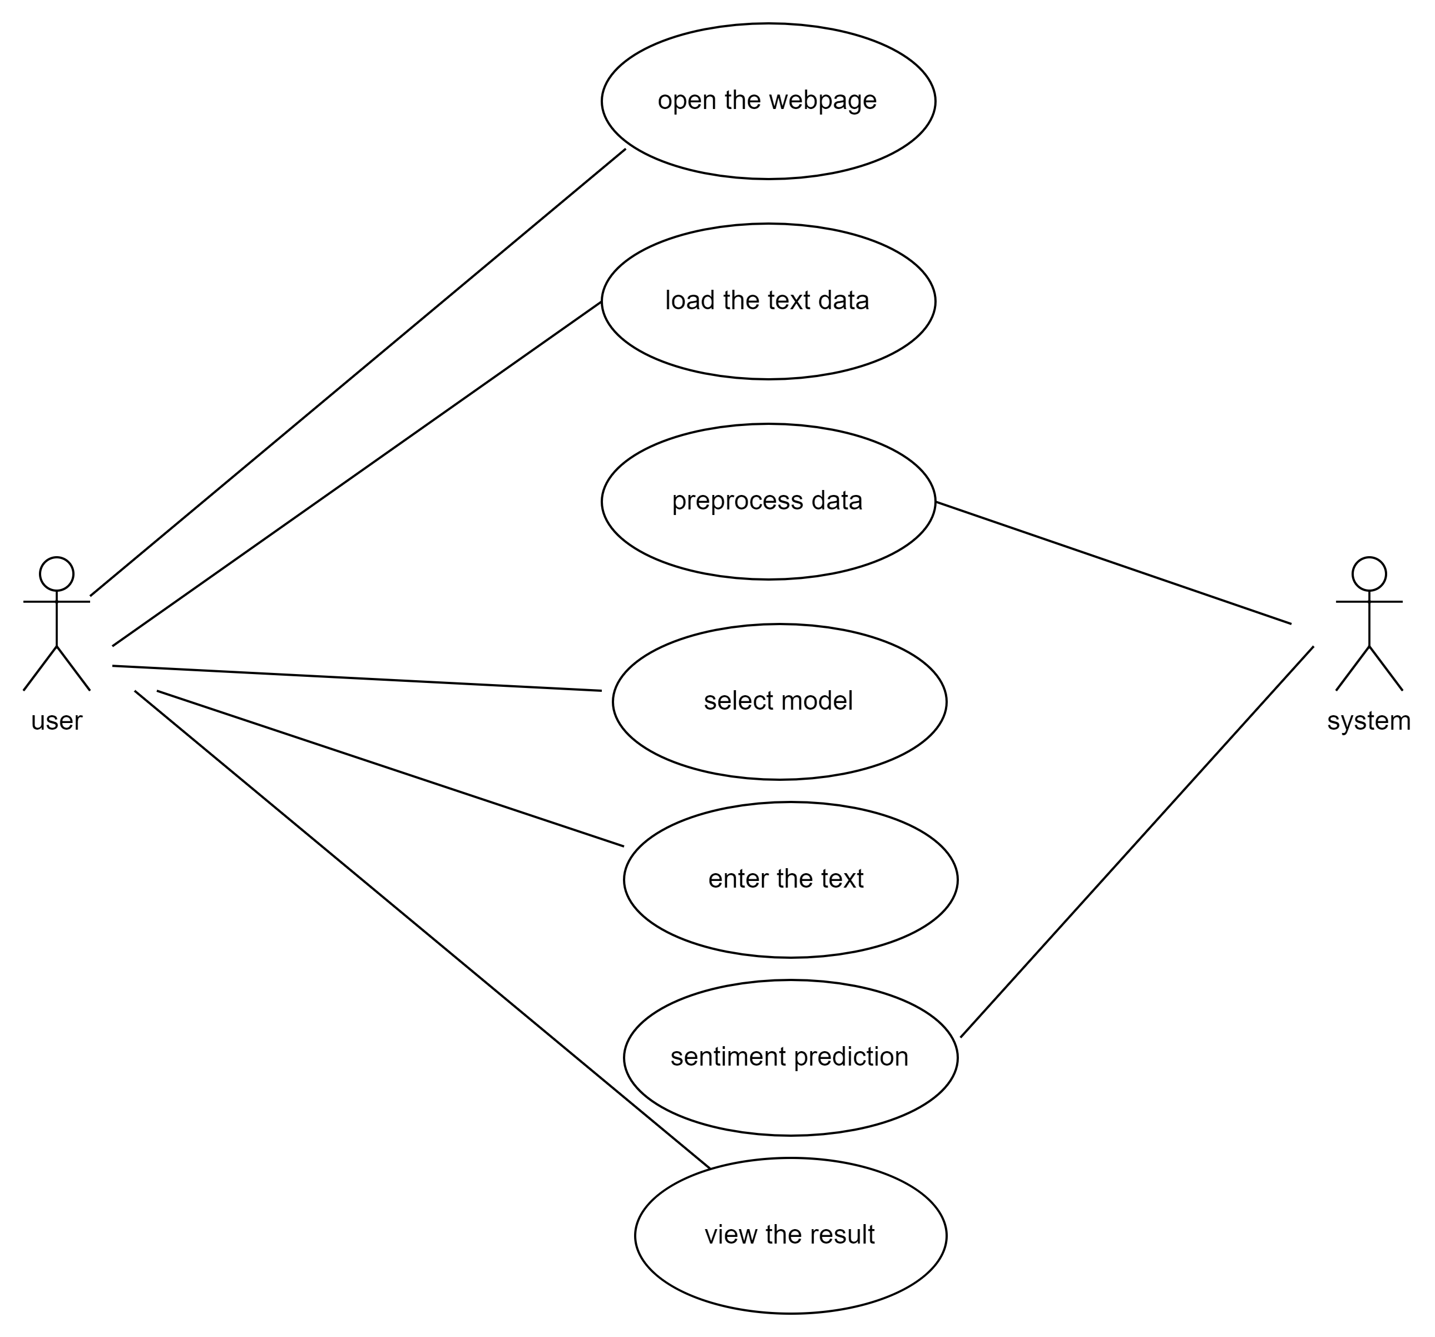
UML DIAGRAMS
USECASE DIAGRAM

Slide 16
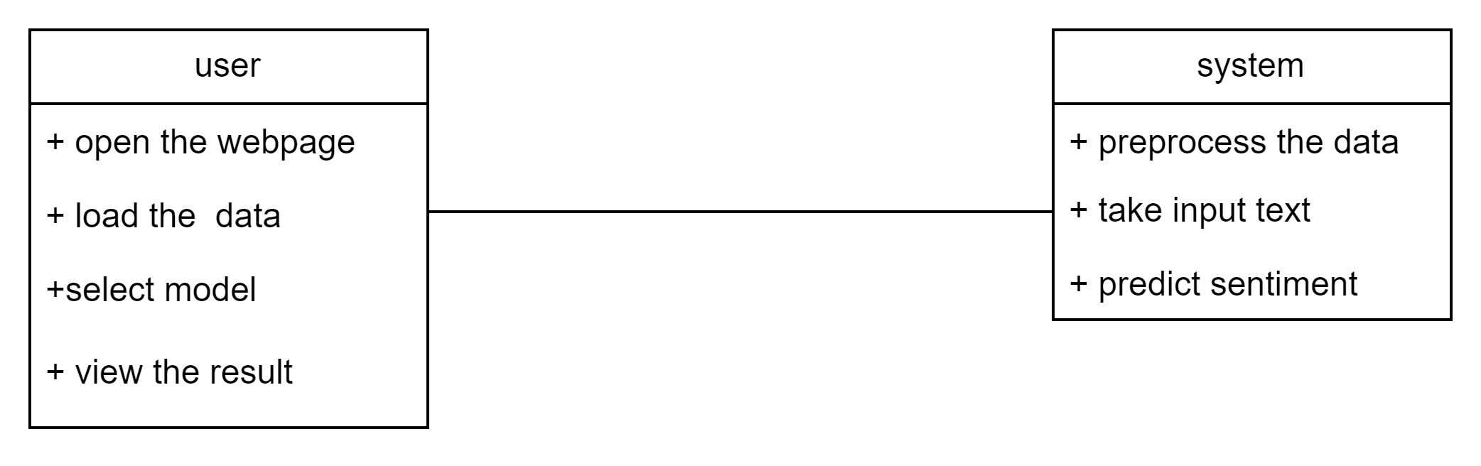
CLASS DIAGRAM

Slide 17
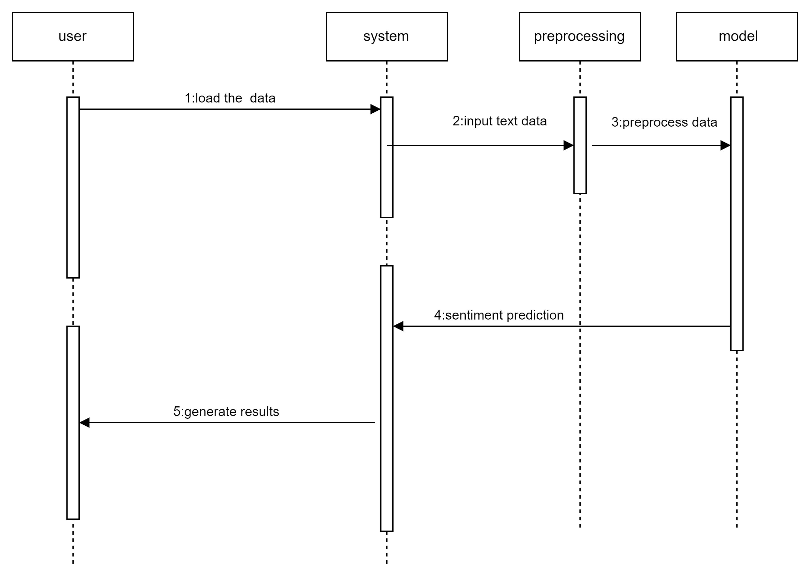
SEQUENCE DIAGRAM

Slide 18
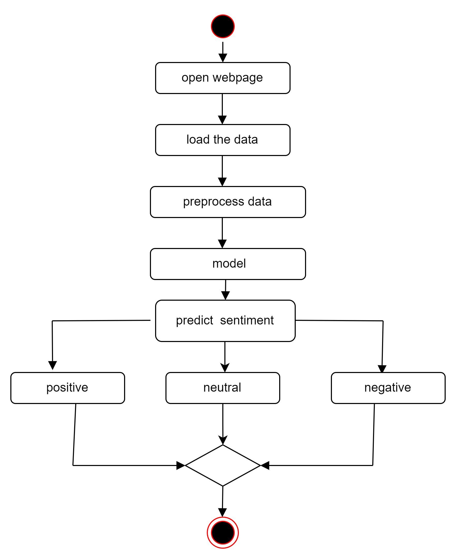
ACTIVITY DIAGRAM

Slide 19

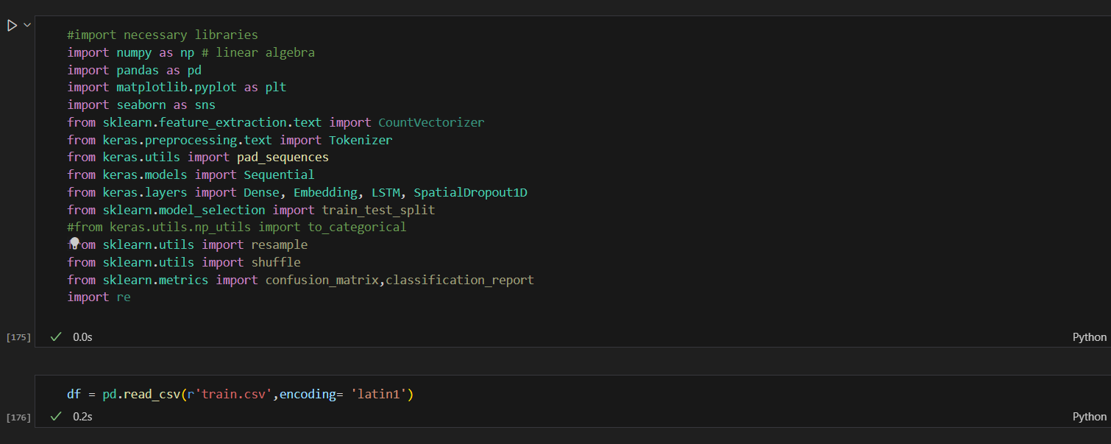
IMPORTING LIBRARIES AND LOADING DATASET

Slide 20
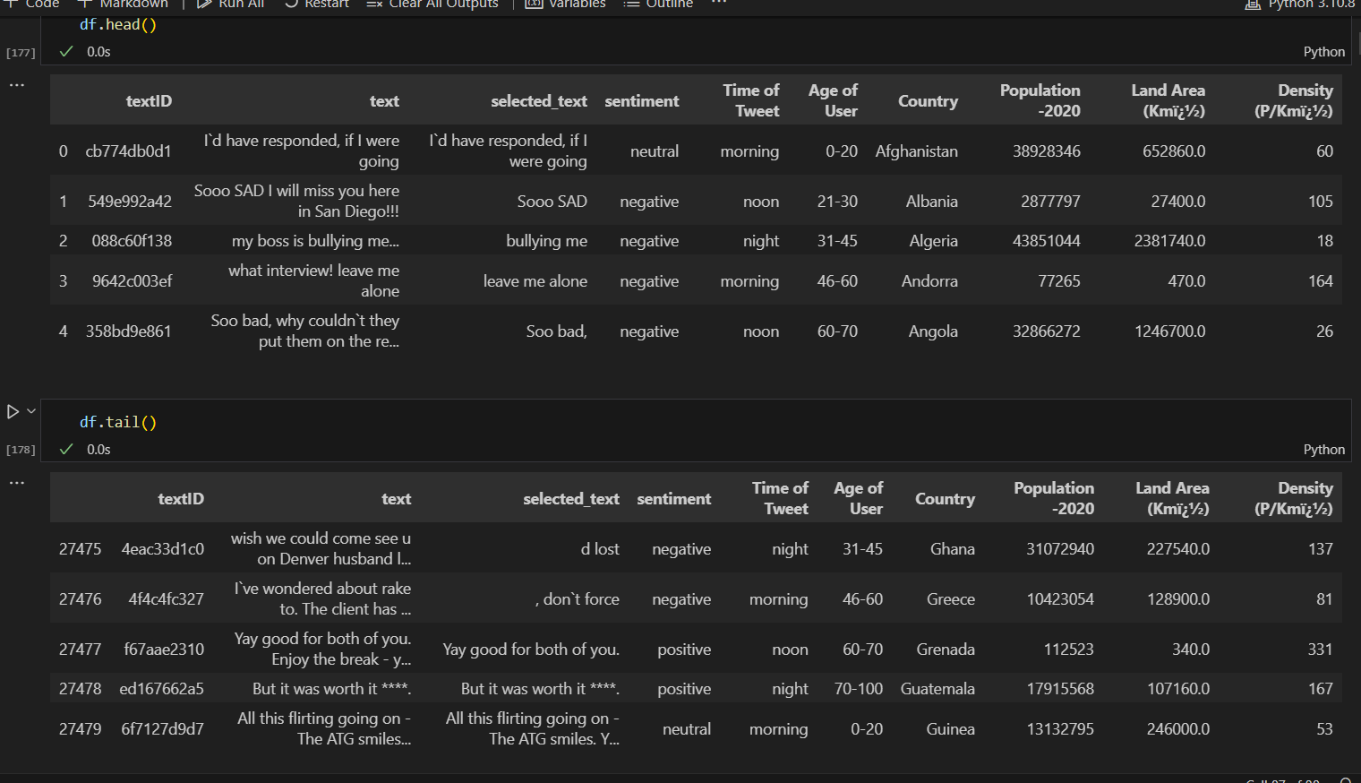

Slide 21
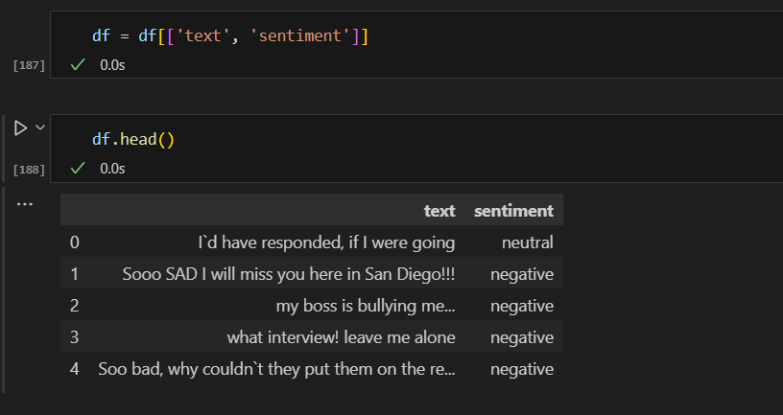
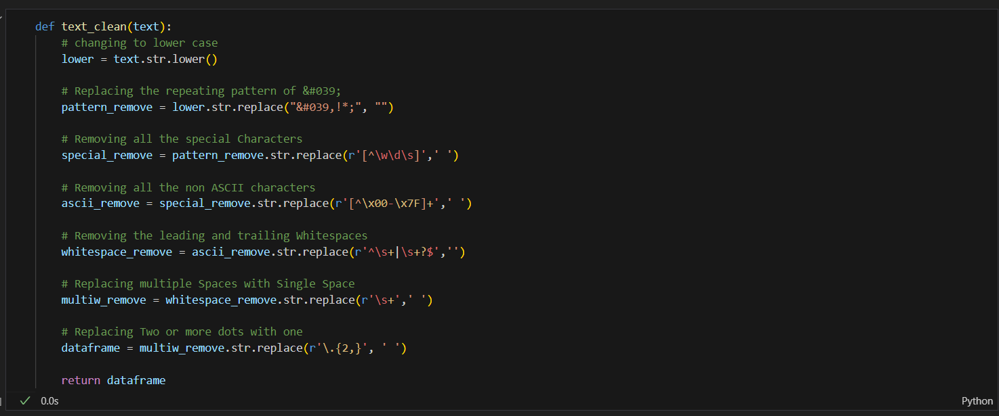
DATA PREPROCESSING AND DATA SPLITTING

Slide 22
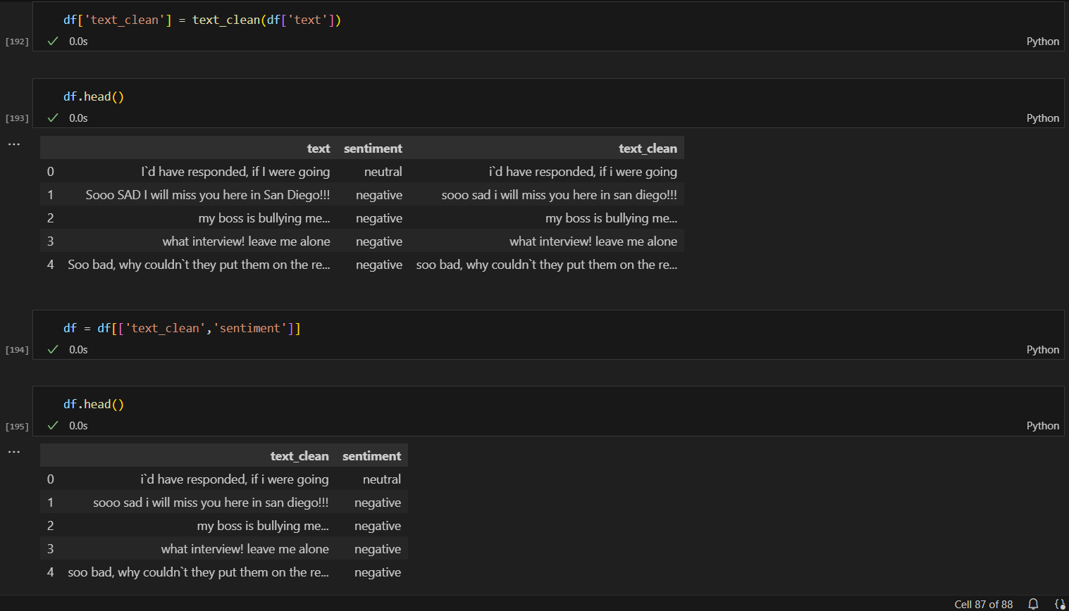

Slide 23
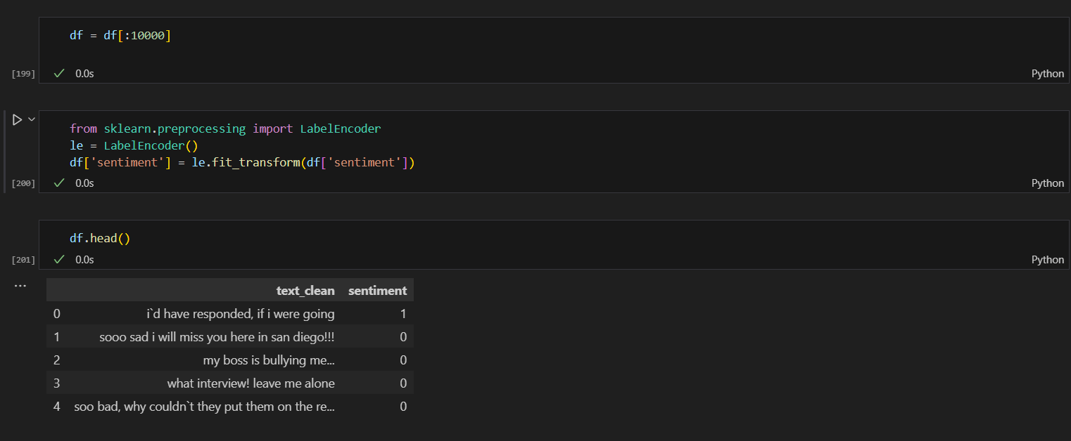
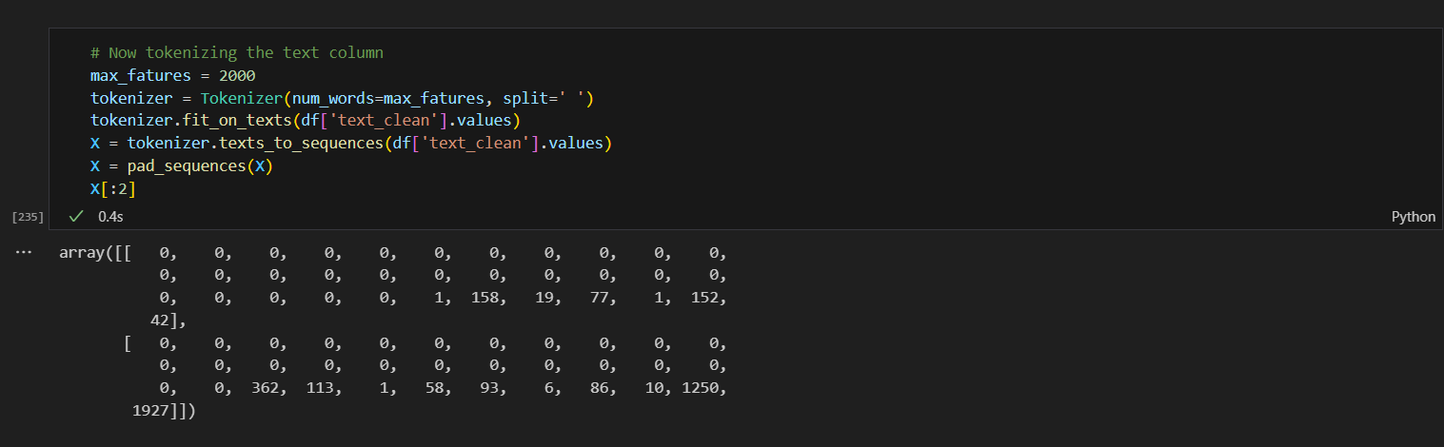

Slide 24
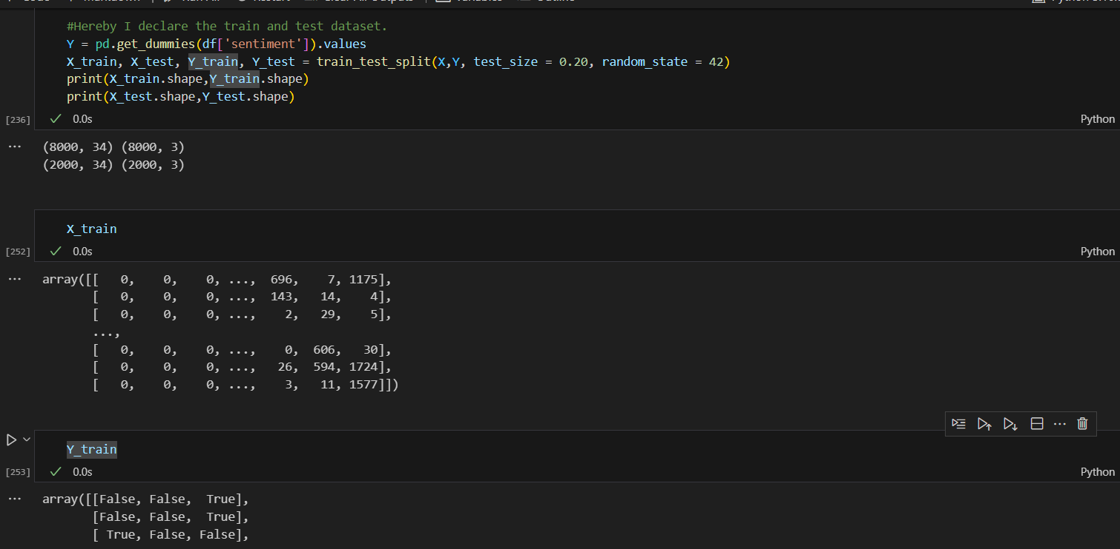

Slide 25
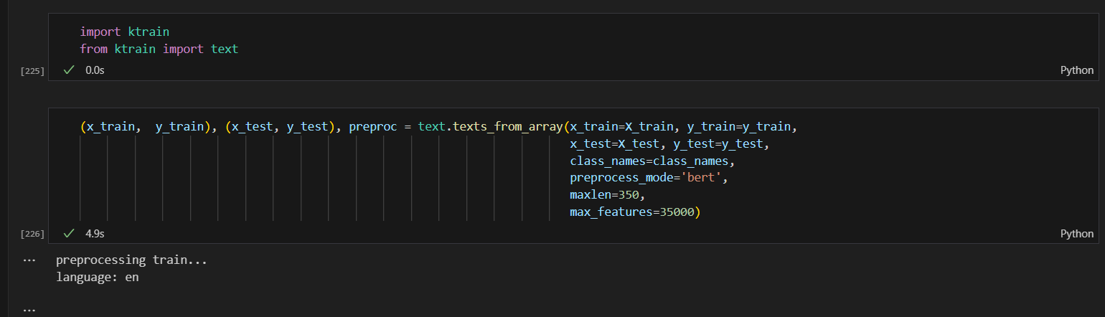
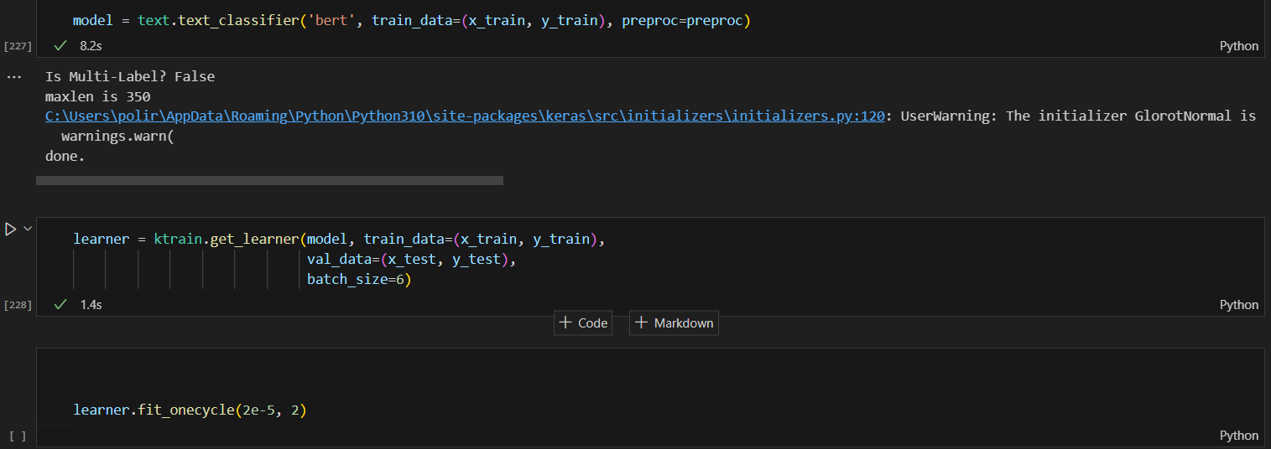
MODEL BUILDING AND EVALUATION

Slide 26
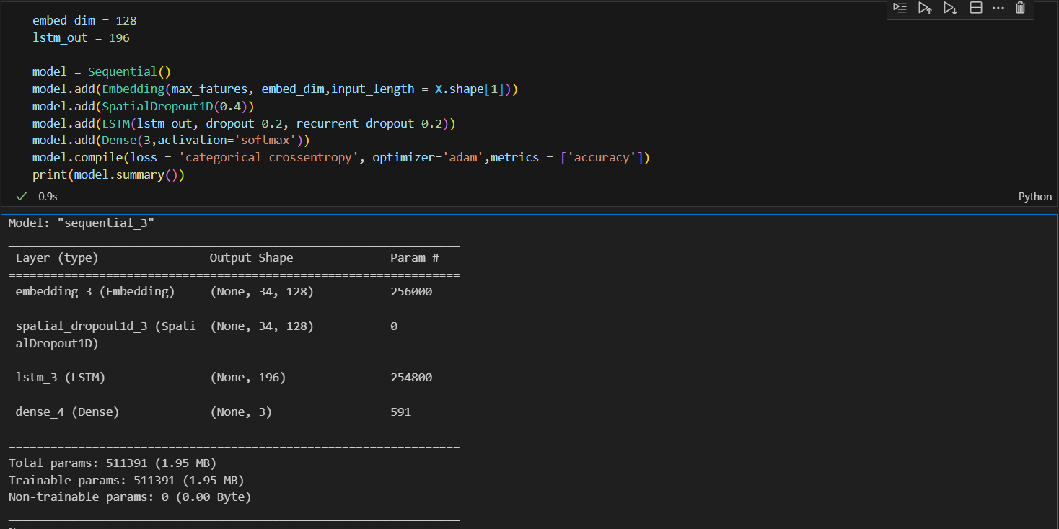

Slide 27
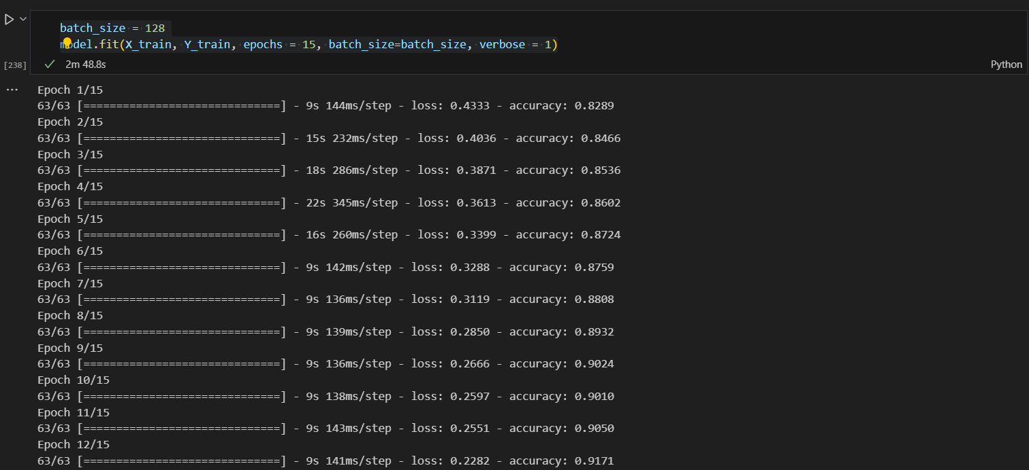

Slide 28
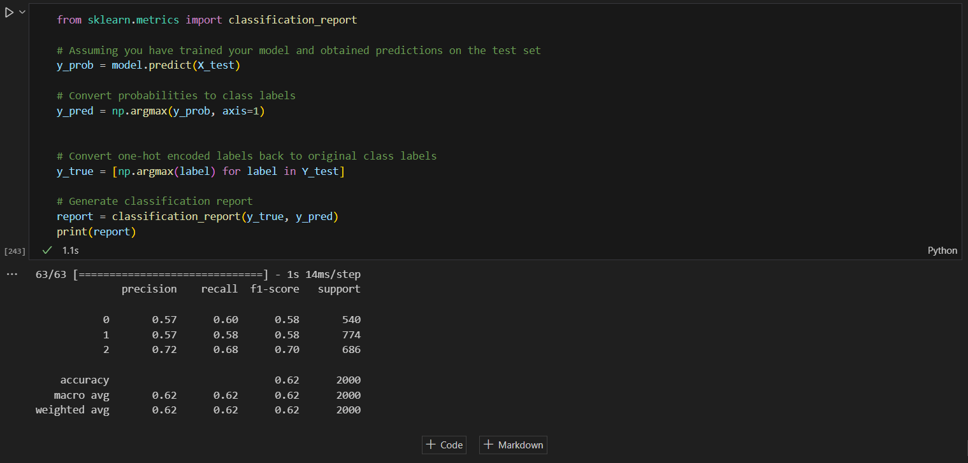

Slide 29
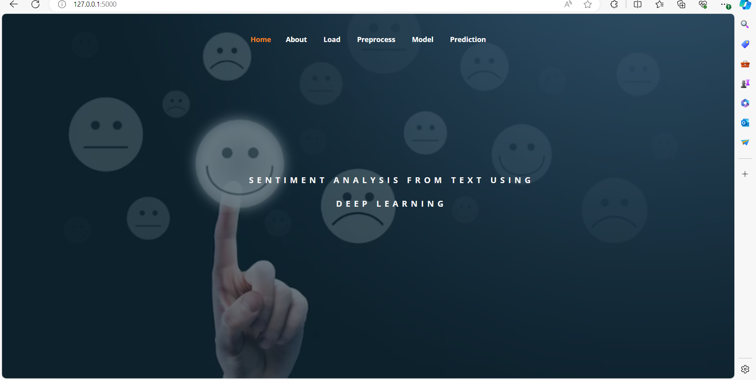
OUTPUT SCREENS

Slide 30
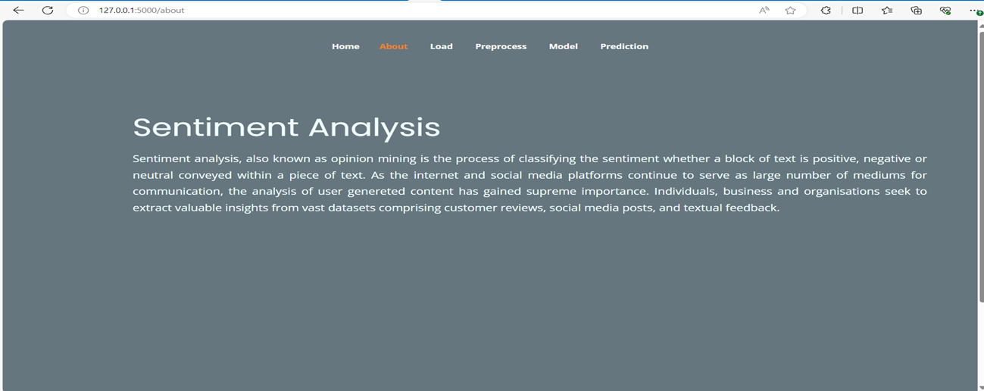

Slide 31
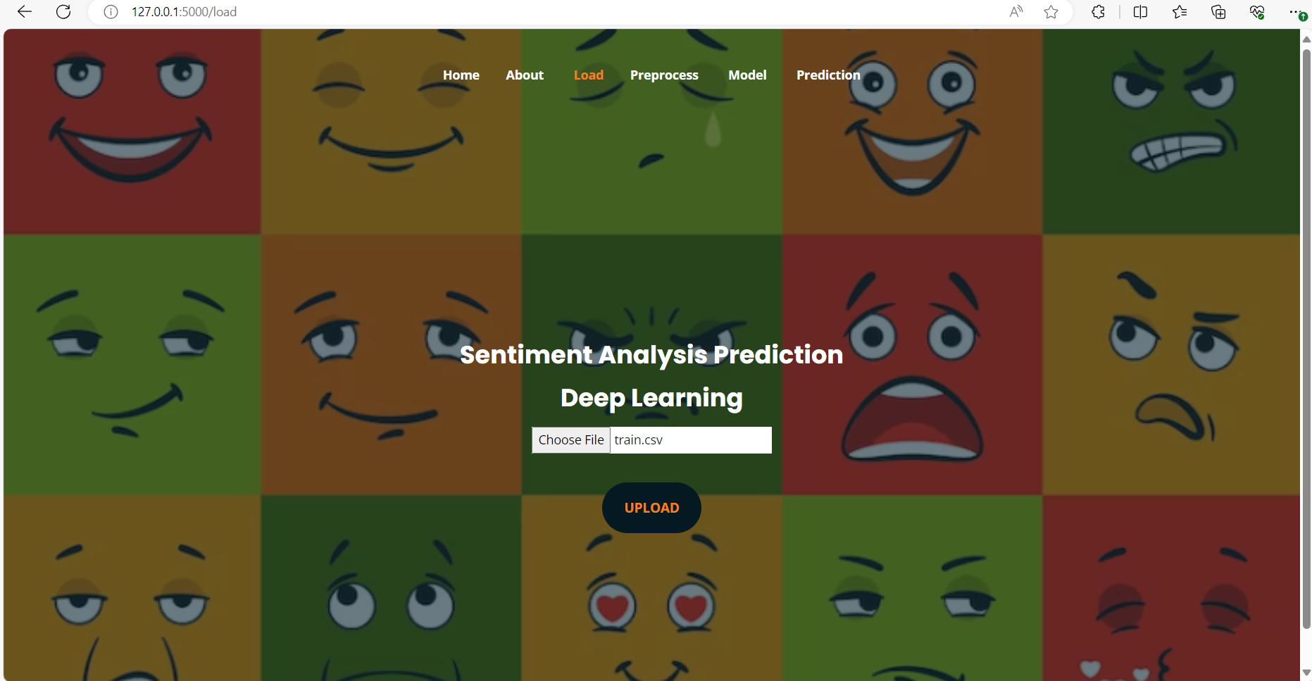
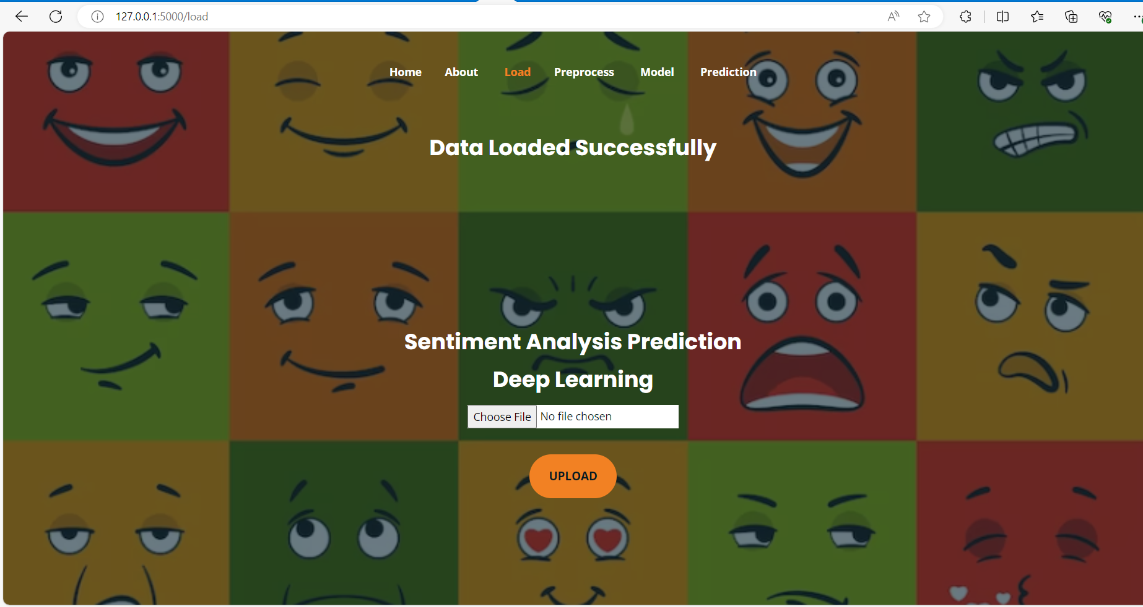

Slide 32
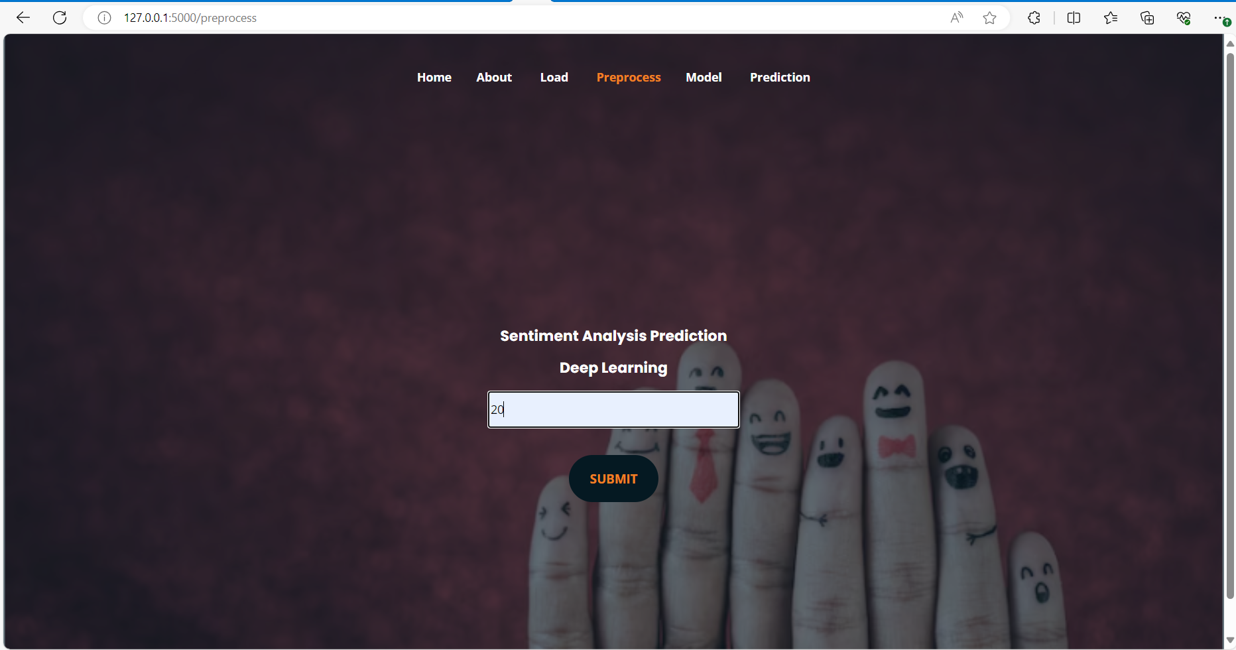
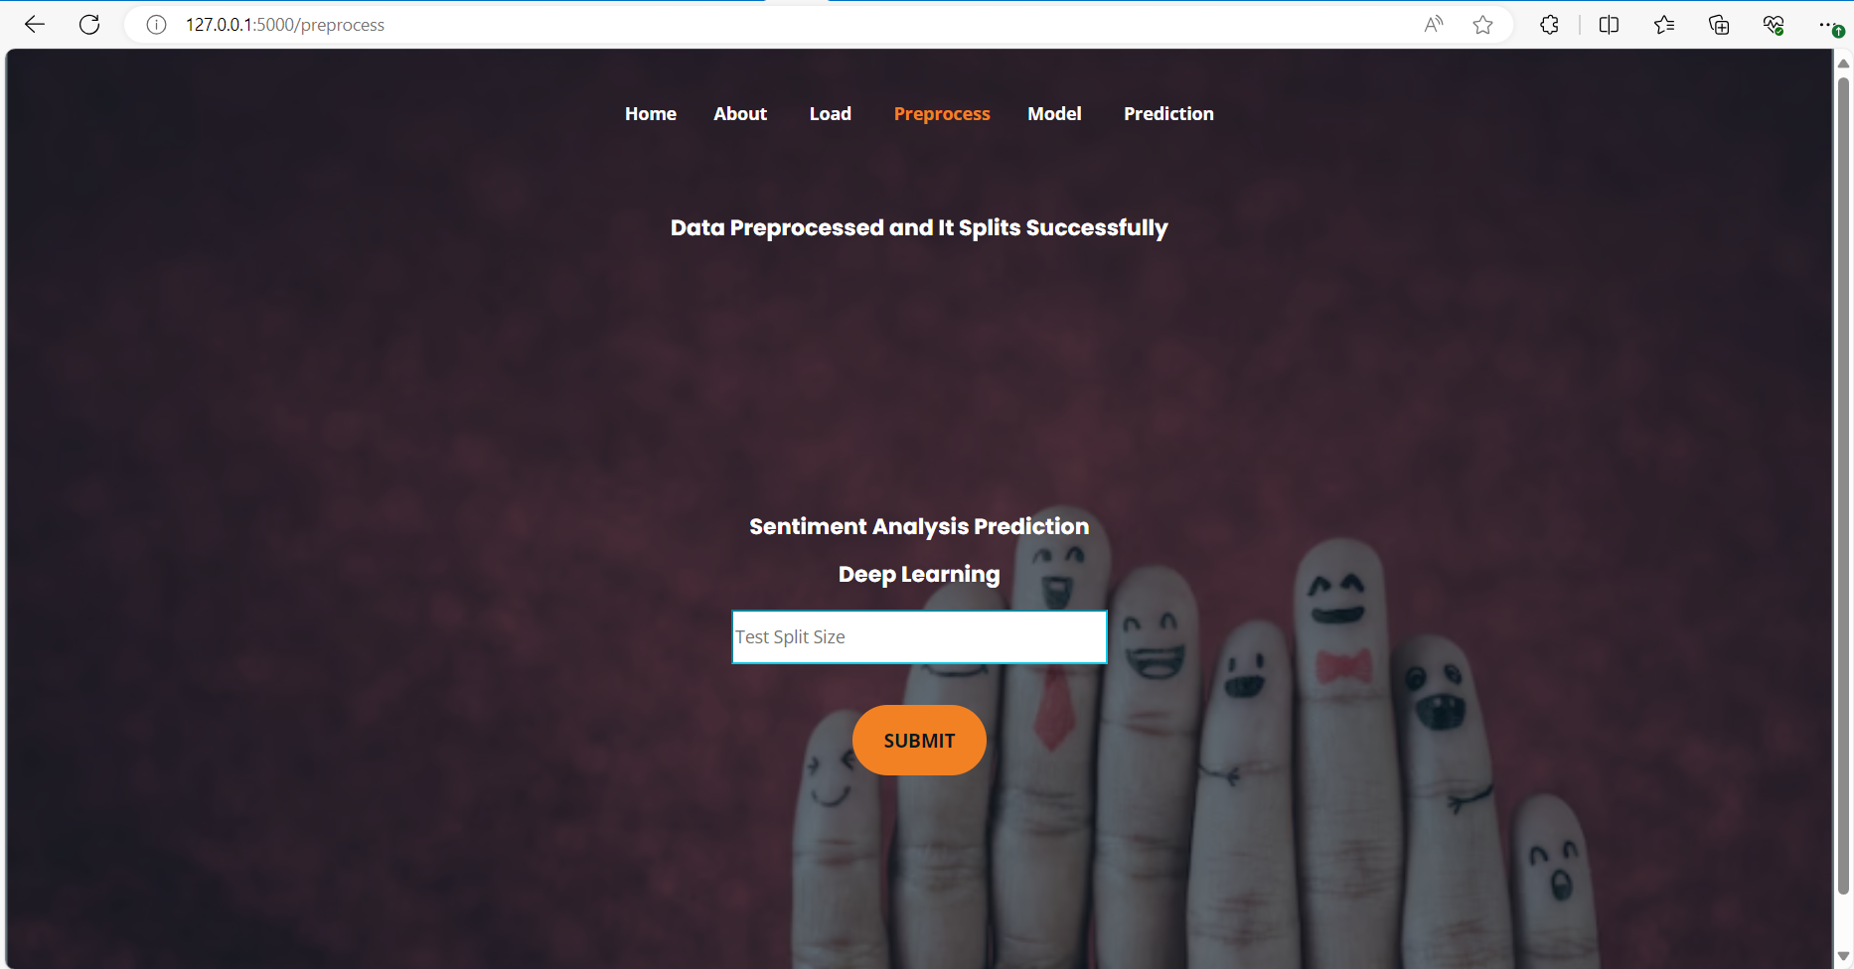

Slide 33
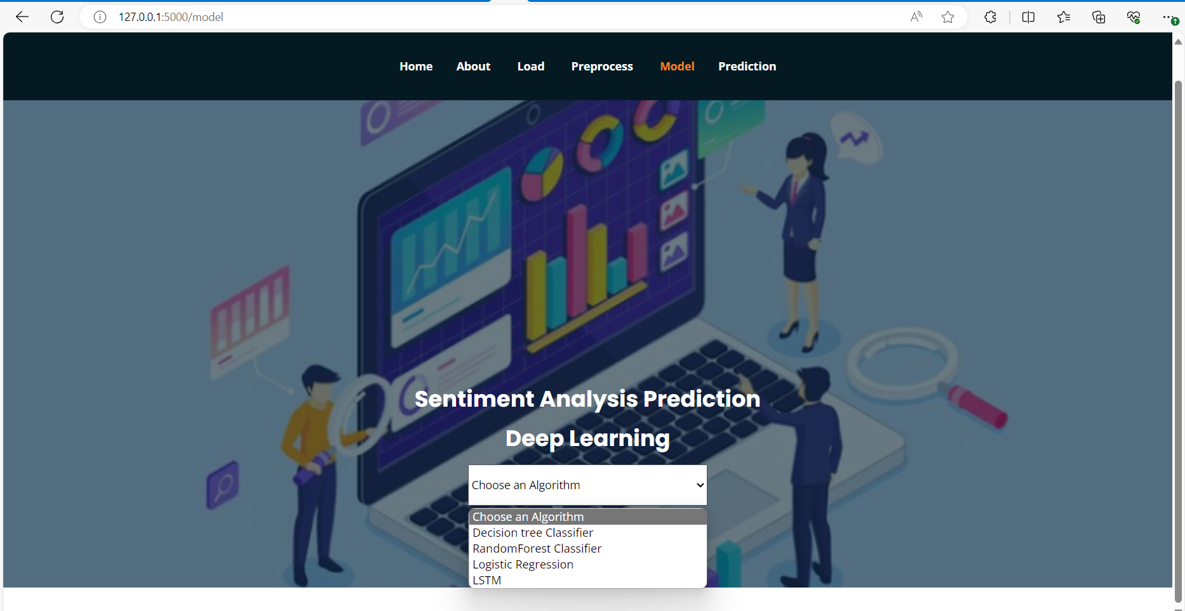
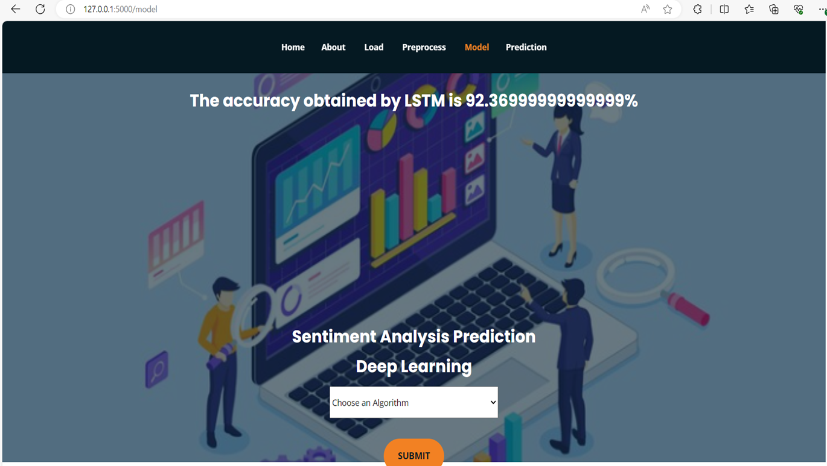

Slide 34
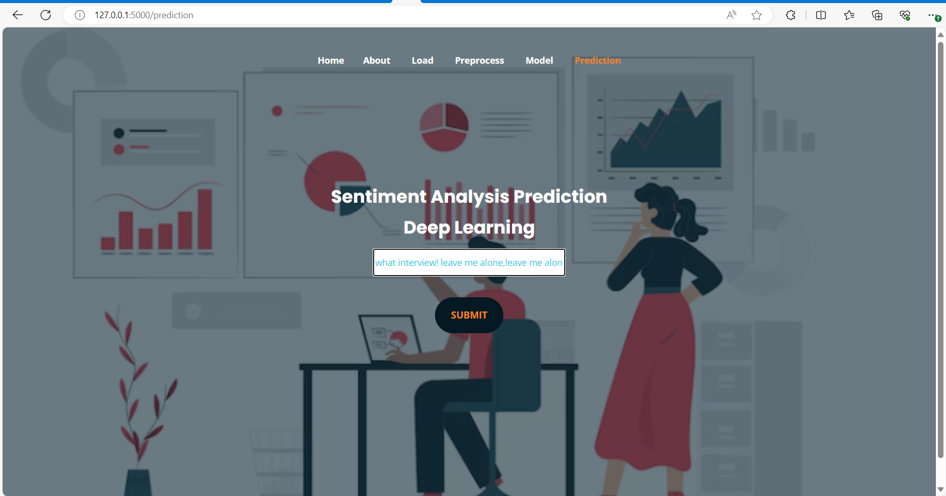
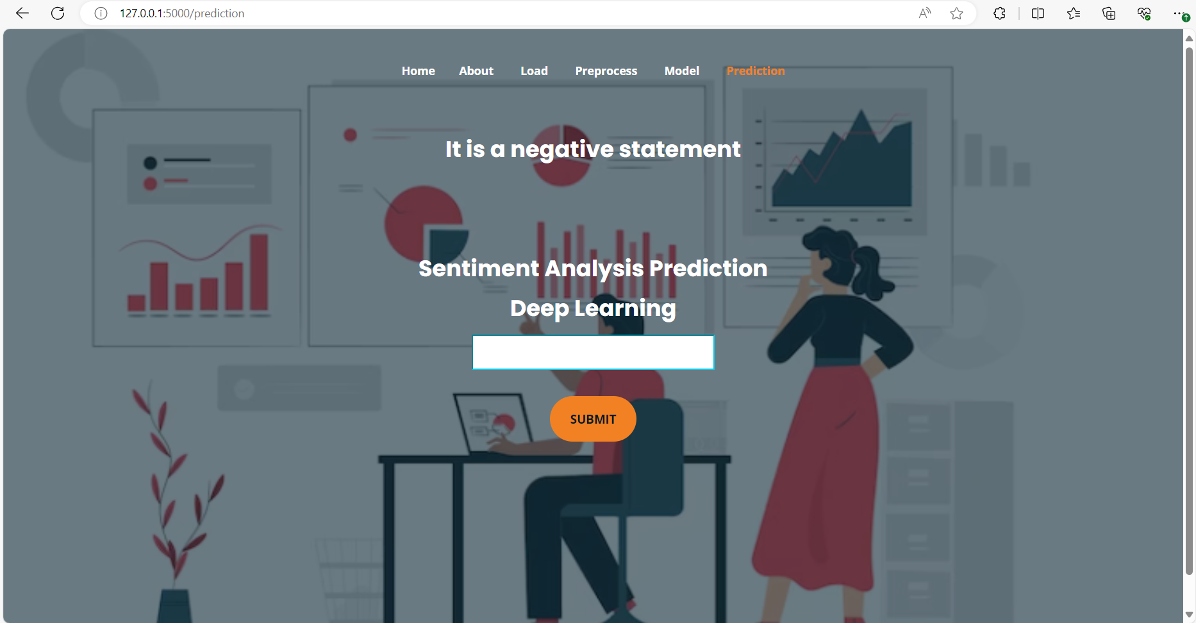

Slide 35
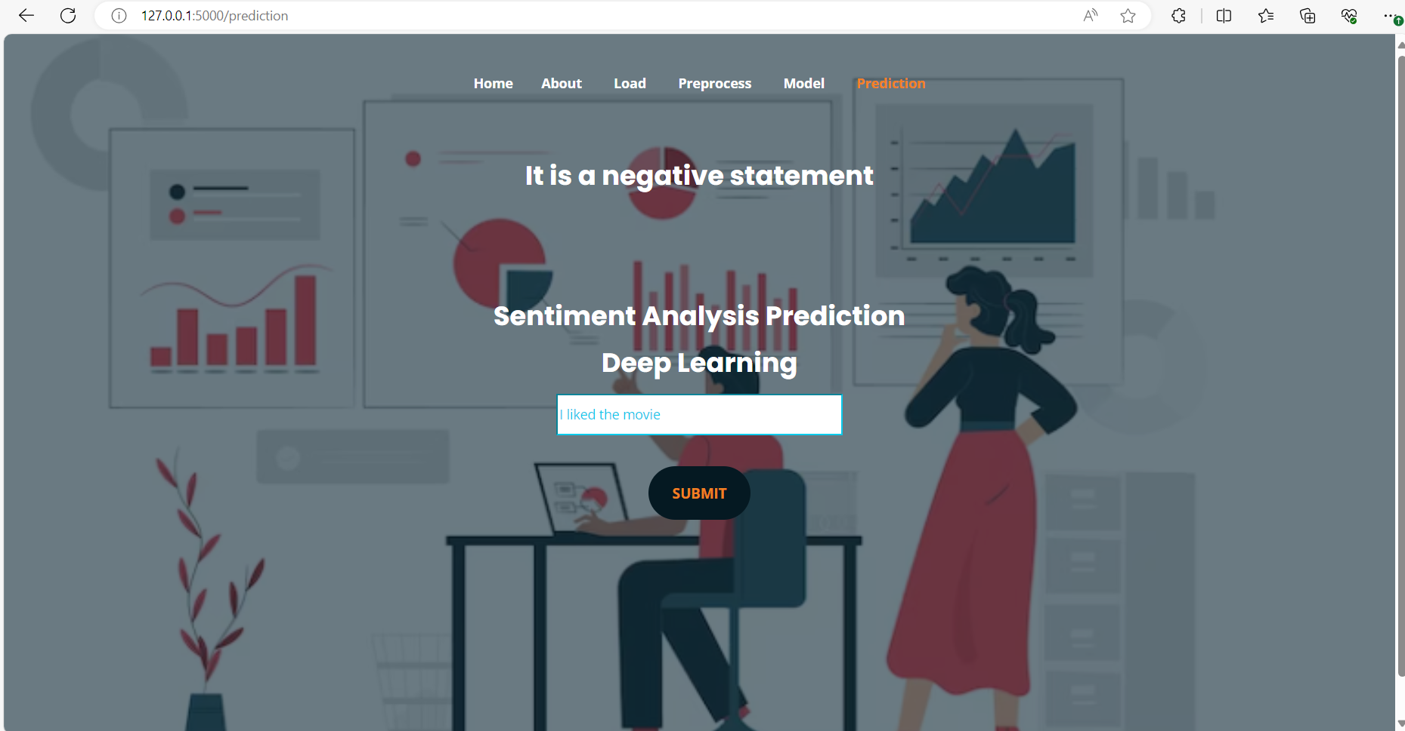
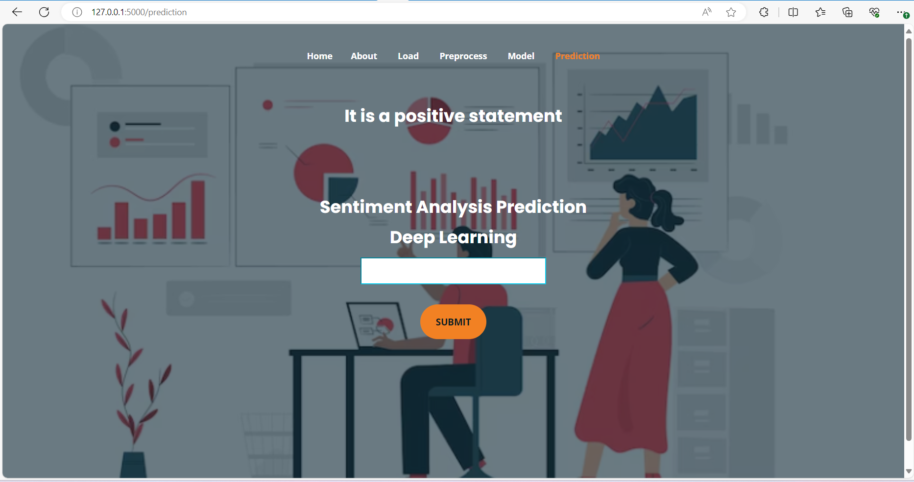

Slide 36

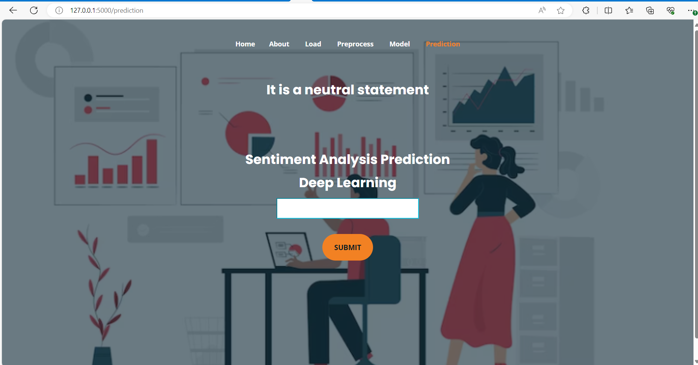

Slide 37

CONCLUSION
The conclusion of this project is that the developed model can classify the sentiment by analyzing the text data. The machine learning algorithms like Decision Tree Classifier, Random Forest Classifier and Logistic Regression have accuracies 61.2%, 58.5% and 62.3% respectively. The proposed deep learning model LSTM have 92.3% accuracy. So the deep learning model used to make sentiment predictions accurately.
FUTURE SCOPE
This can be implemented in future to identify the emotions and types of genres from the text or documents. Multilingual sentiment analysis uses sentiment analysis models that can process and analyse text in multiple languages.

Slide 38
REFERENCES
1. G. Mohanty and P. Mishra, ‘‘Sad or glad? Corpus creation for Odia poetry with sentiment polarity information,’’ in Proc. 19th Int. Conf. Comput. Linguistics Intell. Text Process. (CICLing), Hanoi, Vietnam, 2018.
2. Y. Hou and A. Frank, ‘‘Analysing sentiment in classical Chinese poetry,’’ in Proc. 9th SIGHUM Workshop Lang. Technol. Cultural Heritage, Social Sci., Hum. (LaTeCH), 2015, pp. 15–24.
3. A. Ghosh, G. Li, T. Veale, P. Rosso, E. Shutova, J. Barnden, and A. Reyes, ‘‘SemEval-2015 task 11: Sentiment analysis of figurative language in Twitter,’’ in Proc. 9th Int. Workshop Semantic Eval. (SemEval), 2015, pp. 470–478.

Slide 39
THANK YOU

